Slide 1


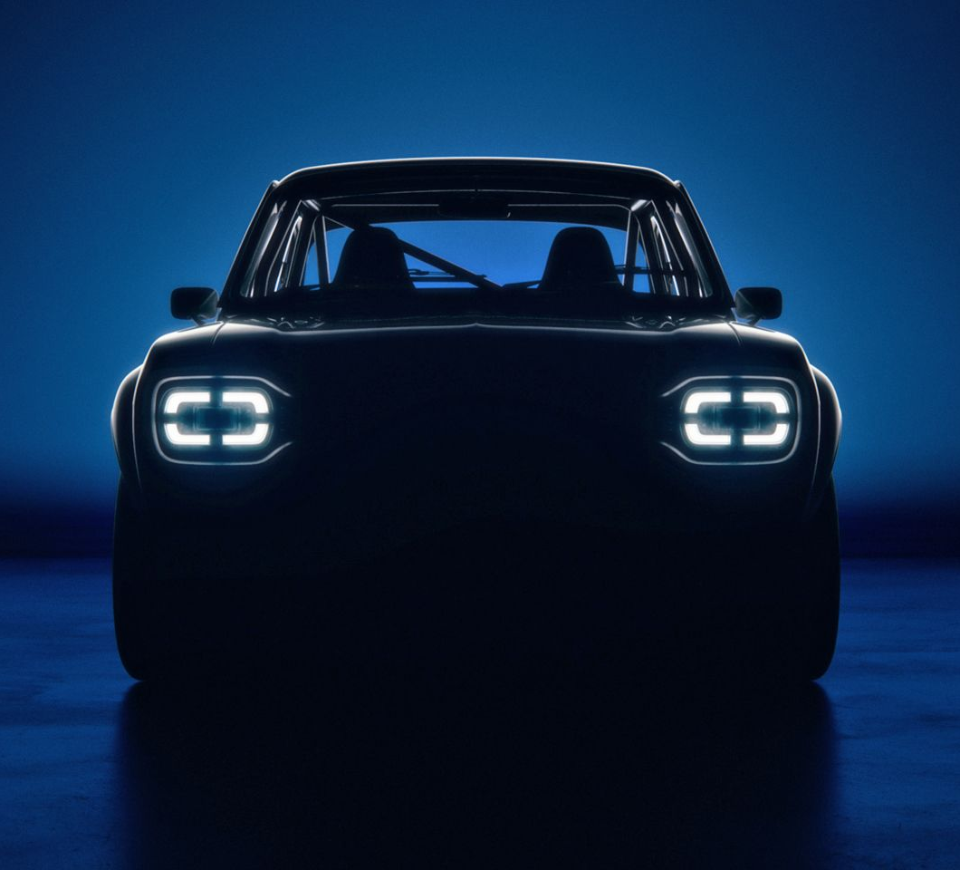
CARMAgeDDoN
Computer Vision and Machine Learning project

Slide 2
CARMAgeDDoN
Car
Analysis and
Recognition via
Machine-learning for
Automotive
Disambiguation with
Deep Learning
Networks

Slide 3
Project goals
Brand identification of car
Model identification of car
Ideally: Chassis-code identification (variants)
Support goals:
Usability of image (scoring)
Angle of image (scoring)

Slide 4
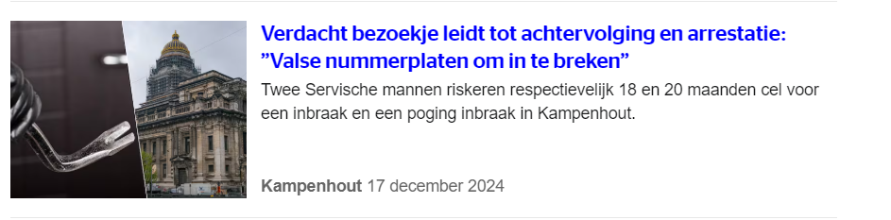
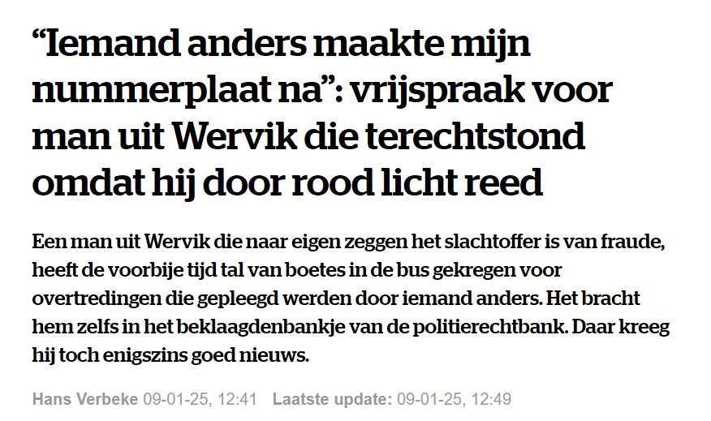
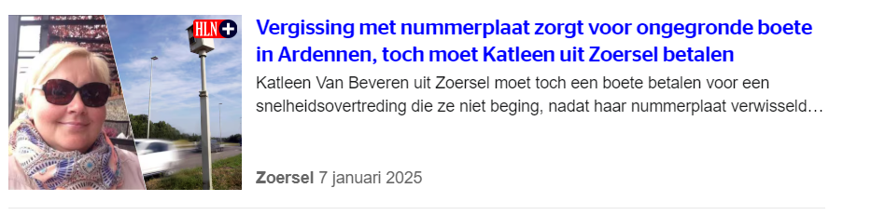
Impact
License plate fraud

Slide 5
Impact
License plate fraud
LEZ
MOT-stations
ANPR-verification
App (ObsIdentify for cars)
…

Slide 6
DATA (sourcing)
Downsized proposal from larger idea
Autoscout
Listings:
Images
Brand
Model / model ID
Support features
Autodoc
Chassis codes
There be dragons:
Data linking

Slide 7
Data description & EDA

Slide 8
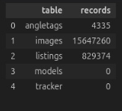


15,6 million images (839GB)
829 thousand listings

Slide 9
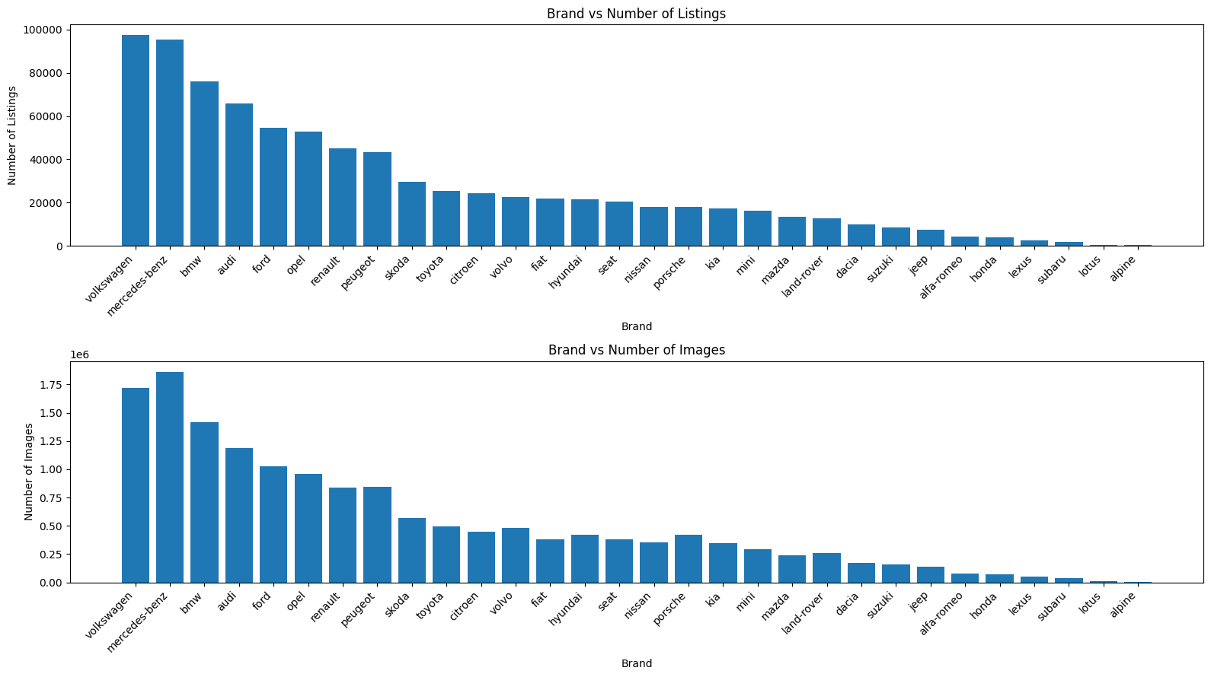

Slide 10
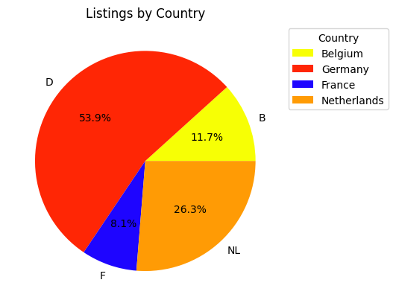

Slide 11
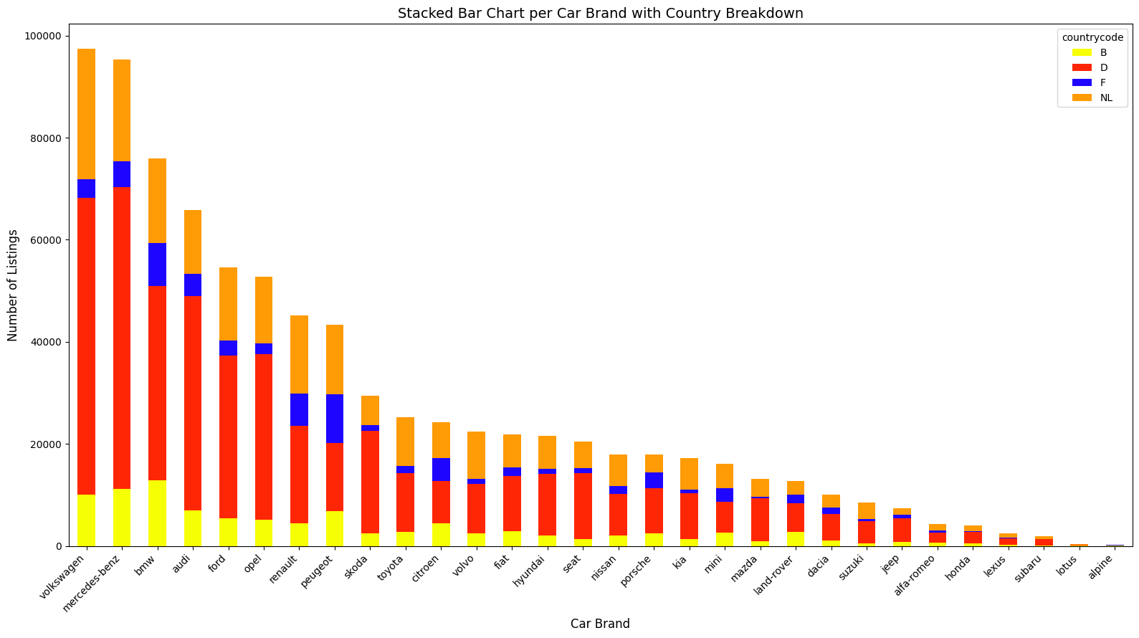

Slide 12
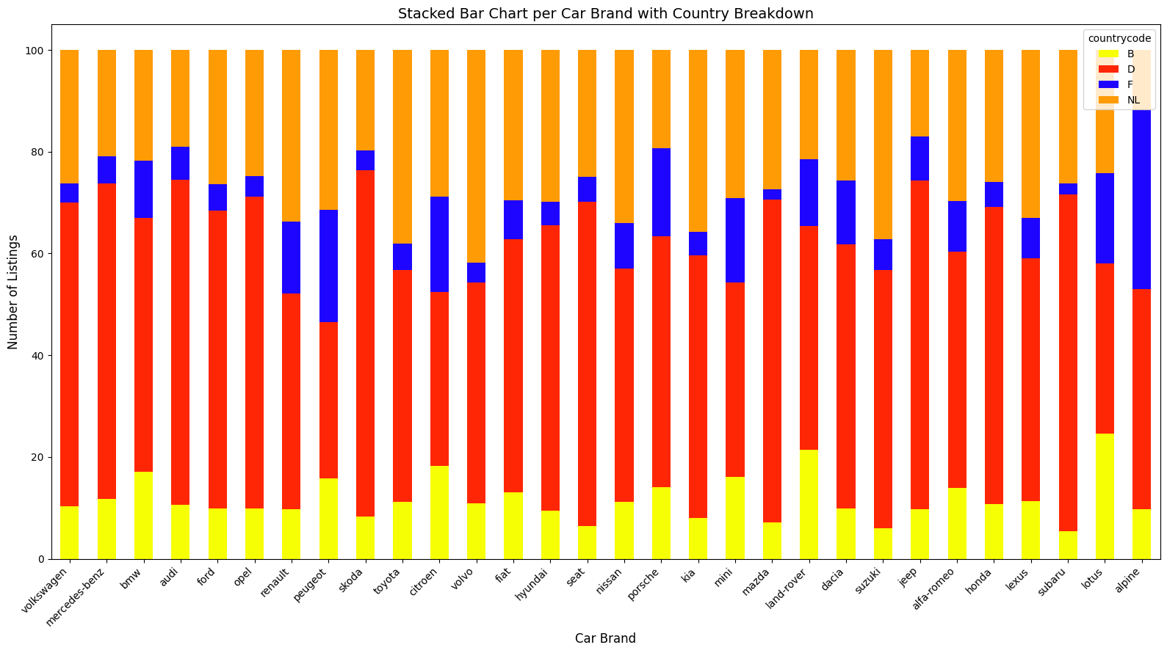

Slide 13
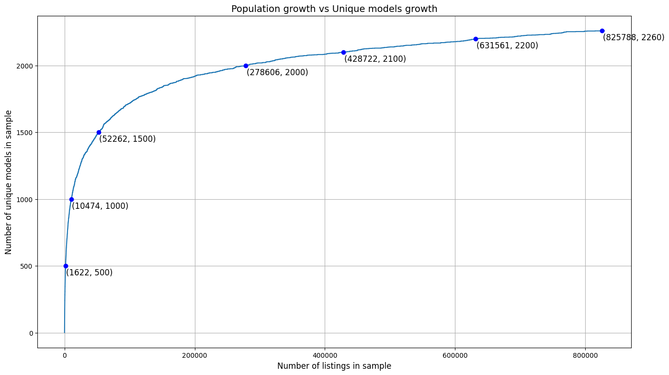

Slide 14
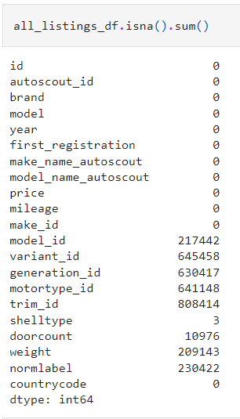















Slide 15
Project intended implementation

Slide 16
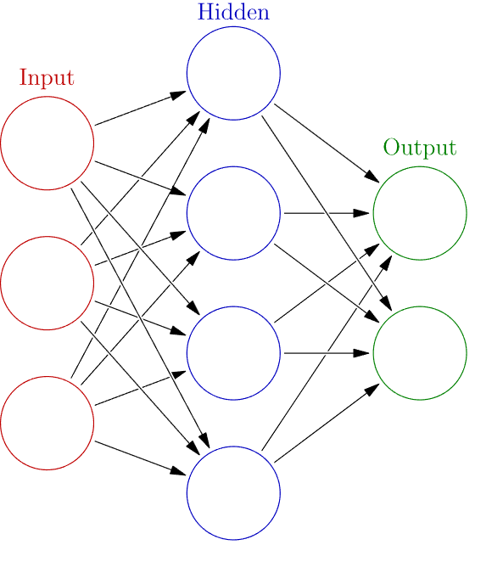


Deliverable pipeline
CNN1:
Bin tag
angle tag
CNN2:
brand classification
Bounding box:
x1,y1
x2,y2
CNN3a:
Model classification (audi)
CNN3b:
Model classification (fiat)

Slide 17
CNN1:
Bin tag
angle tag
CNN2:
brand classification
Bounding box:
x1,y1
x2,y2
CNN3a:
Model classification (audi)
CNN3b:
Model classification (fiat)

Slide 18
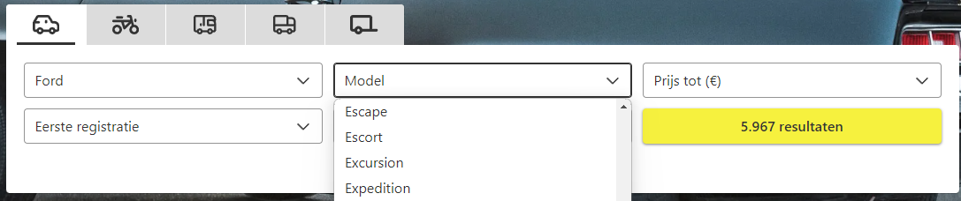
Data harvesting
Data Sources:
Autoscout (Listings)
Autodoc (chassis codes)
Merging data:
Pending task (based on support features)
Doorcount
Registration year
Shell type

Slide 19
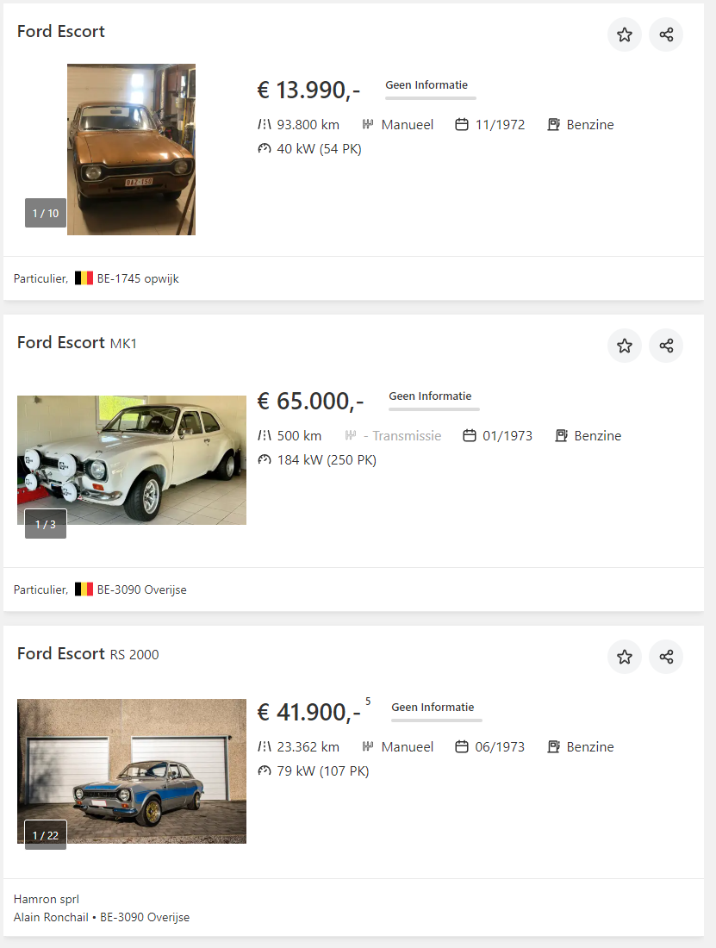
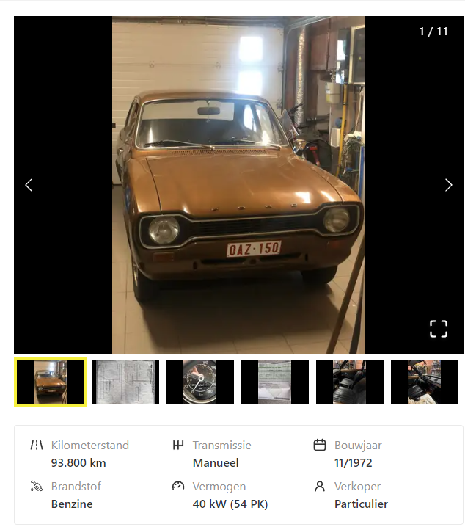
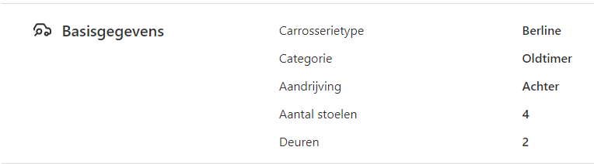
Data harvesting

Slide 20
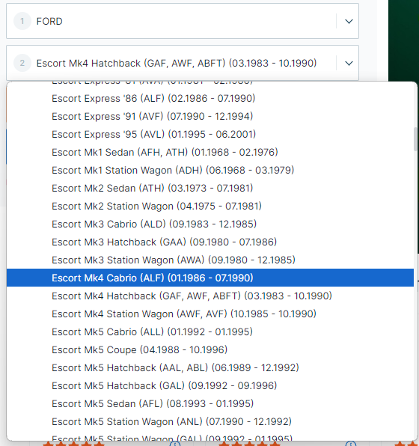
Data harvesting

Slide 21
CNN1:
Bin tag
angle tag
CNN2:
brand classification
Bounding box:
x1,y1
x2,y2
CNN3a:
Model classification (audi)
CNN3b:
Model classification (fiat)

Slide 22
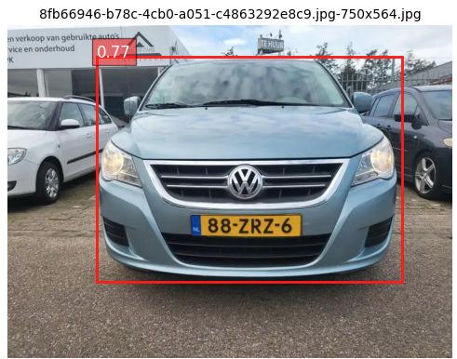
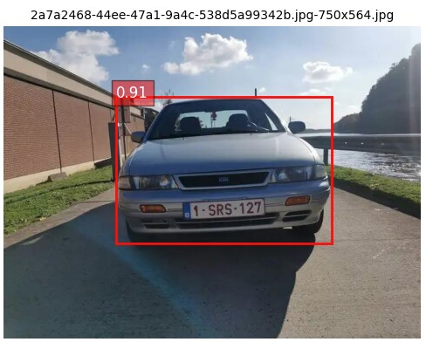
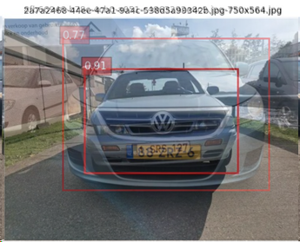
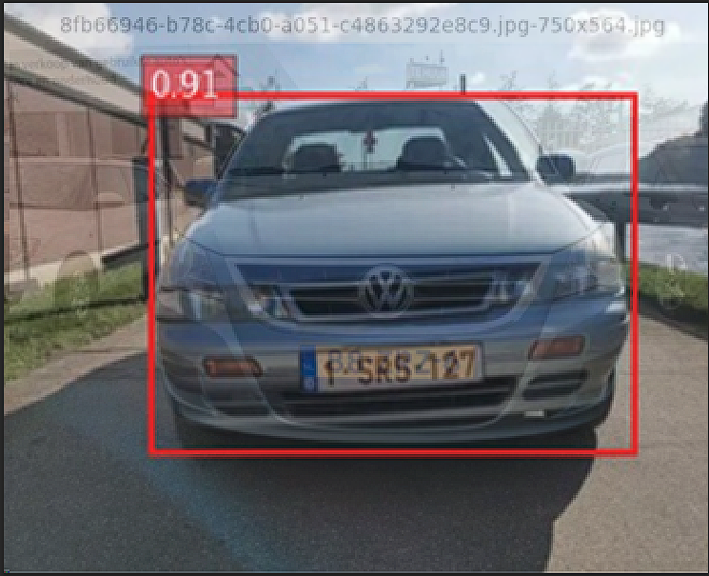
Bounding boxes
Real time object detection:
- https://www.datacamp.com/blog/yolo-object-detection-explained
- Speed (16million images) ➔ ca. 250h
- Custom rules (maxarea, minarea, mincertainty, biggest area…)
- GOAL:
- Crop the image to the relevant bit (the car)
- Why?: Neural networks require a square grid.

Slide 23
CNN1:
Bin tag
angle tag
CNN2:
brand classification
Bounding box:
x1,y1
x2,y2
CNN3a:
Model classification (audi)
CNN3b:
Model classification (fiat)

Slide 24

Bin + angle tag
No training data available:
Is an image useful?
What angle is the image taken at?
Solution: make your own training data
FLASK based tagger
Then Modelling:
2*2models:

Slide 25
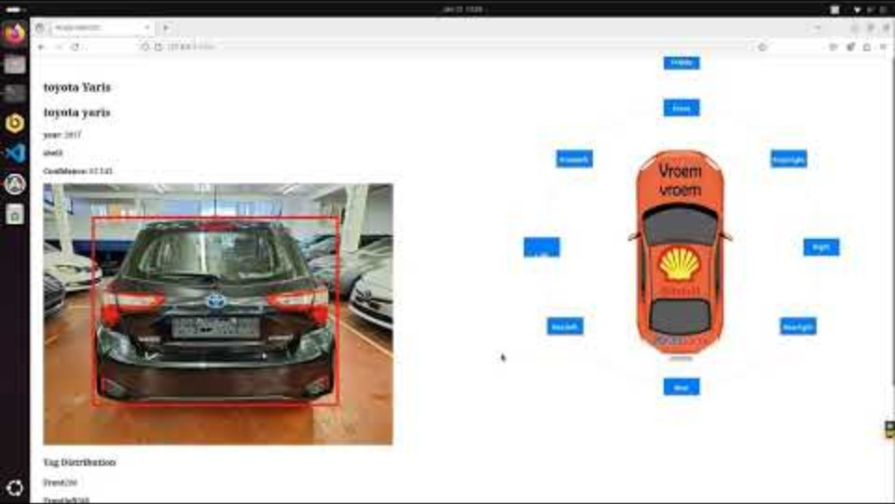



Bin + angle tag

Slide 26
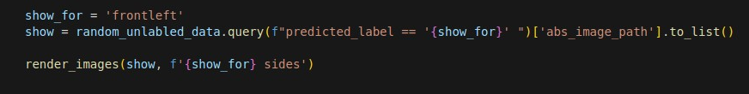
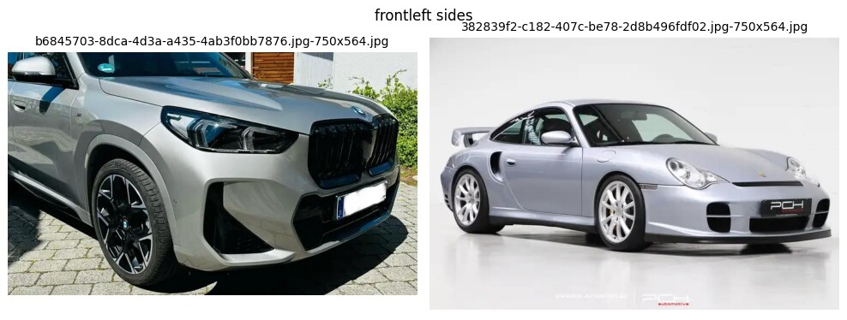
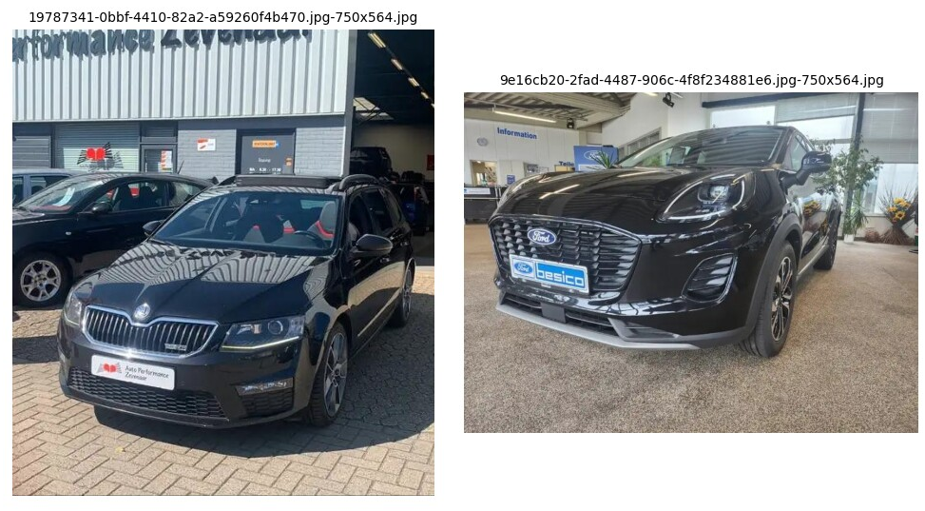


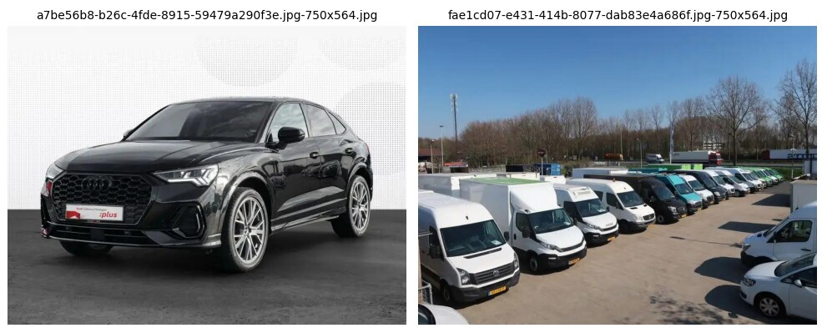
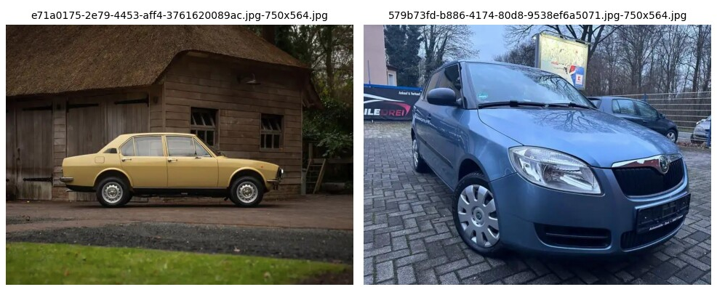
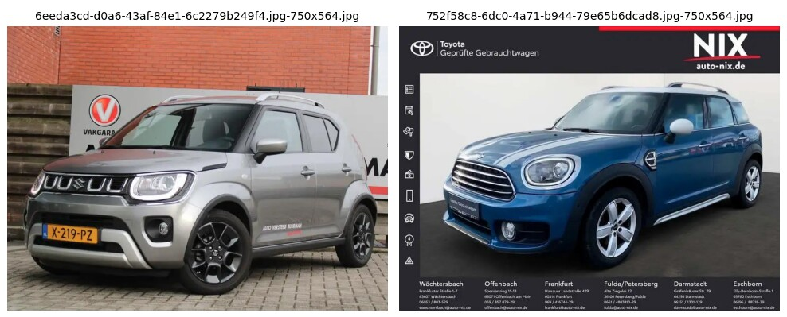
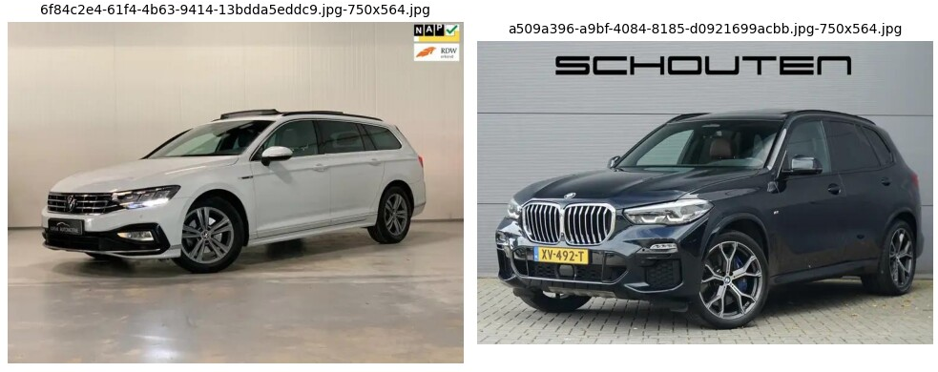
Bin + angle tag
Approach A
CNN | Resnet (feature extraction)
Binary tagger | RandomForest
Bin F1(False) | 94%
Bin F1 (True) | 96%
Angle tagger | KNN(5)

Slide 27
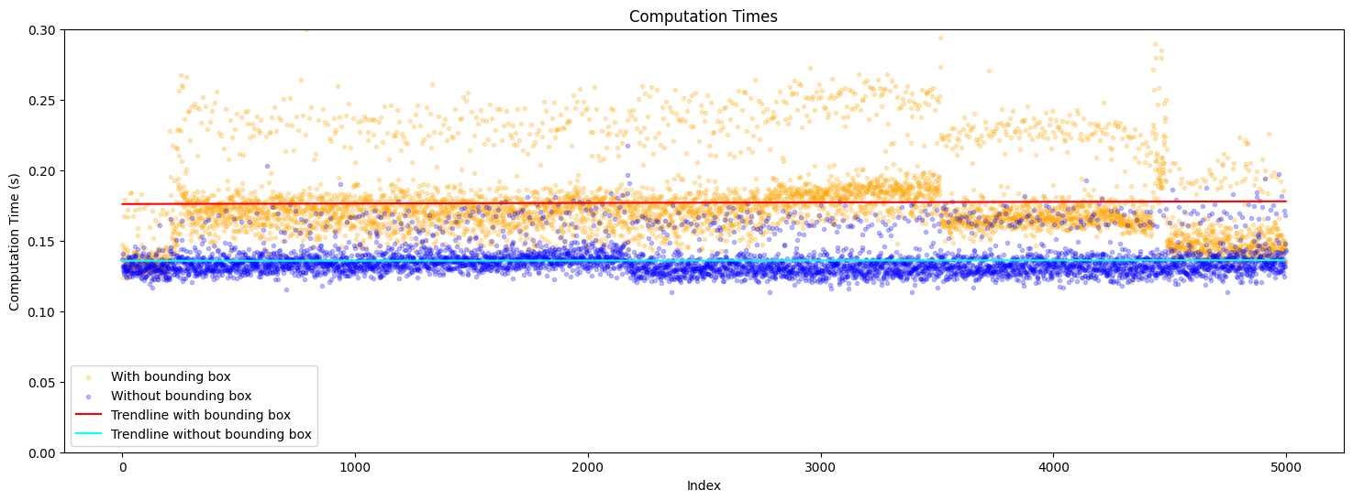
Bin + angle tag

Slide 28
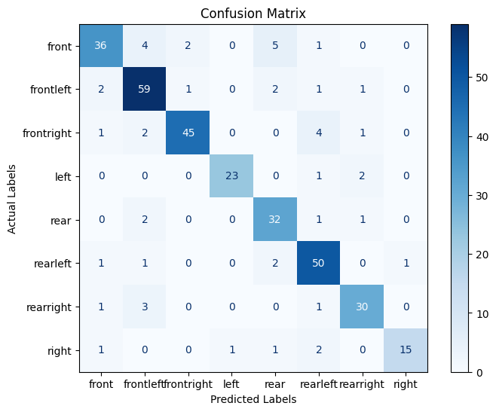
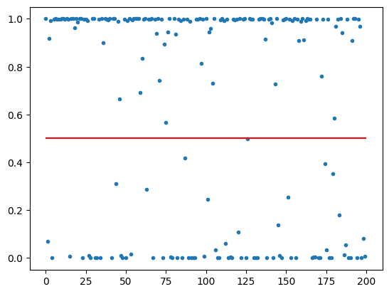
Bin + angle tag
Approach B
CNN | Keras Sequential
Binary tagger | Sequential
Angle tagger | Sequential
Angle tagger: CM
Is_crappy (binary tagger)

Slide 29
CNN1:
Bin tag
angle tag
CNN2:
brand classification
Bounding box:
x1,y1
x2,y2
CNN3a:
Model classification (audi)
CNN3b:
Model classification (fiat)

Slide 30

Brand classification
835GB: So out-of-core learning
Resnet18 (pretrained model)
CPU learning: 10h for 67.740 images
CPU predicting: 5h for 500.000 images

Slide 31
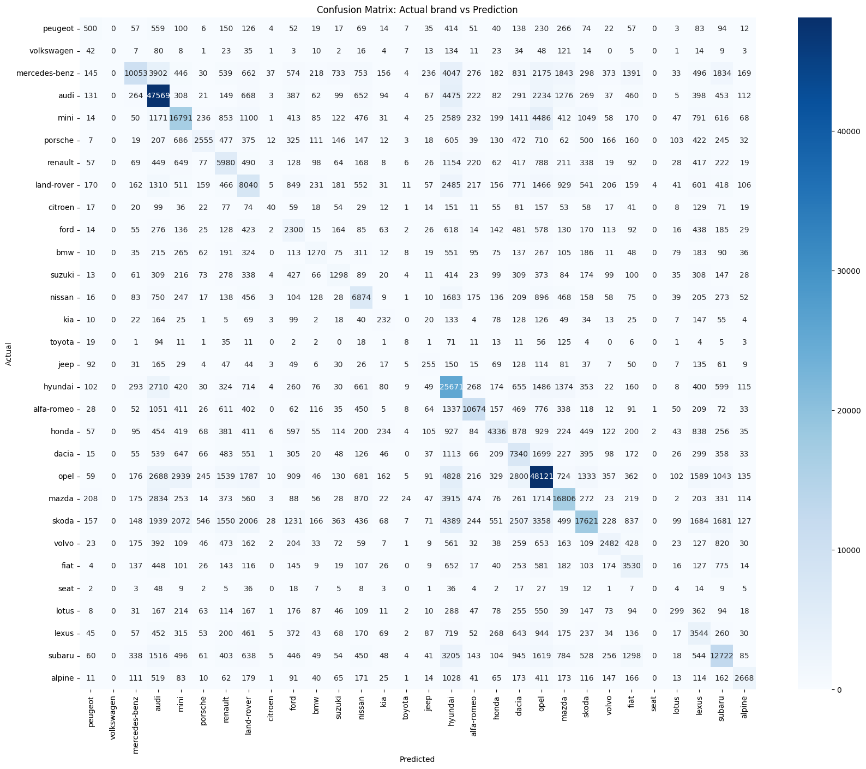
Not great BUT remember:
Preprocessing not fully implemented:
- Binary tagger
- Angle tagger
2) Very small fraction used in training:
- 0,433%

Slide 32

Here be dragons

Slide 33
Dragon1: Model evolution

Slide 34
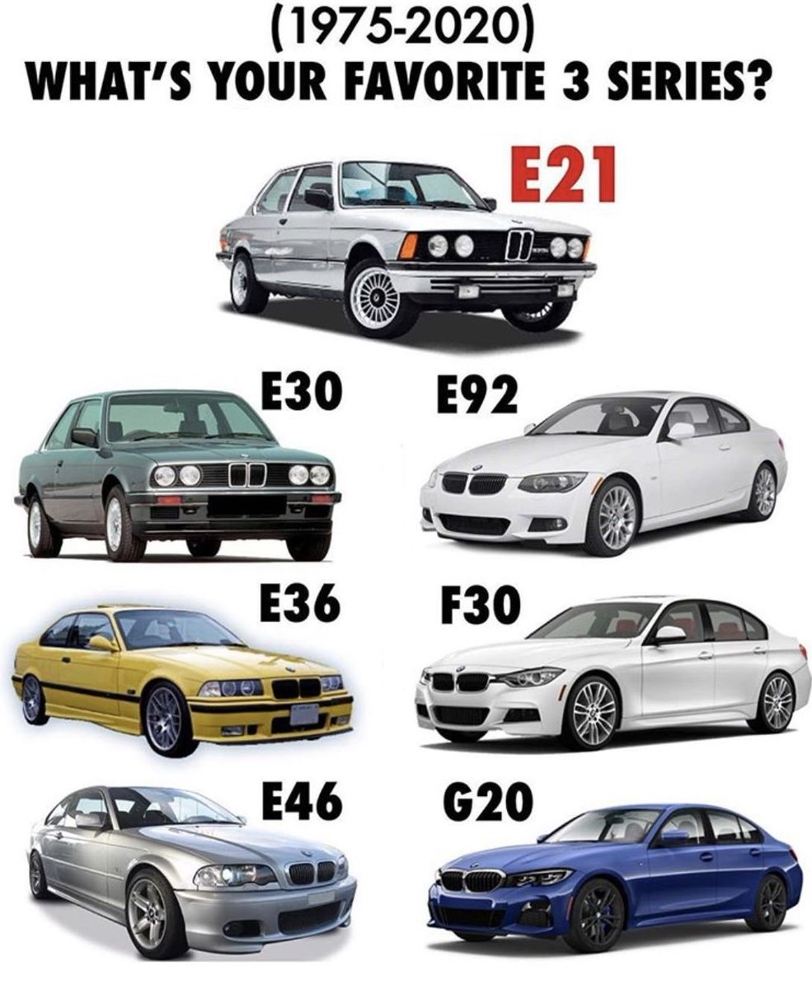
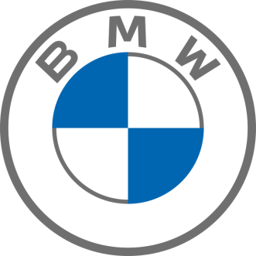
Dragon1: Model evolution

Slide 35


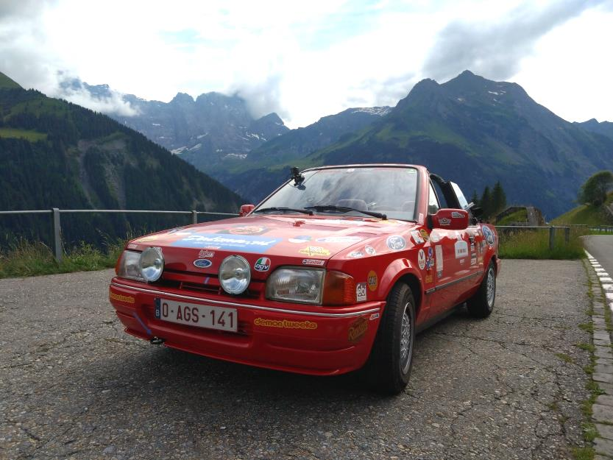
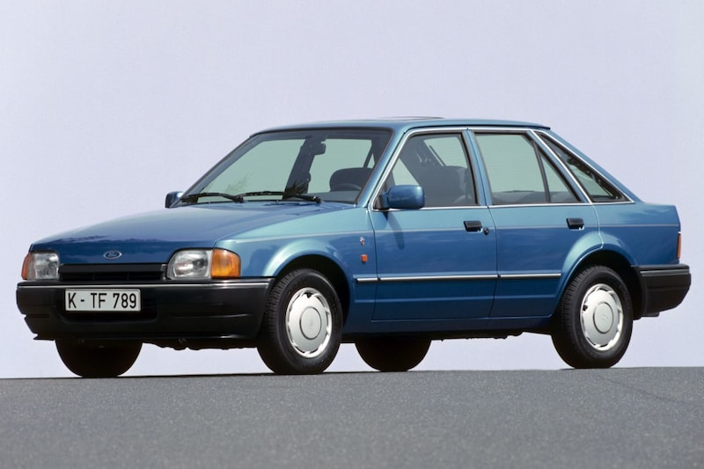
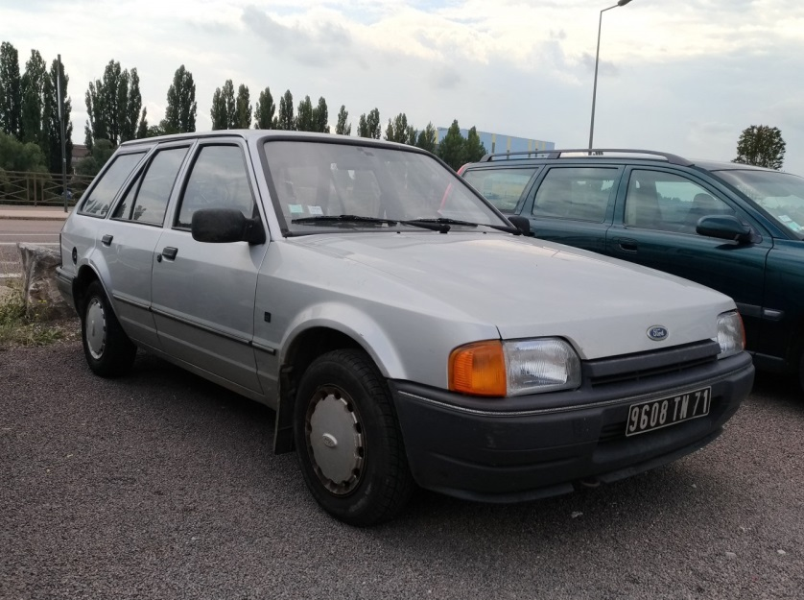
Dragon2: Model Variants
MK IV
Cabriolet:
Escort MK IV (ALF)
Turnier (station wagon):
Escort MK IV (AVF)
5door hatch:
Escort MK IV (AWF)
3door hatch:
Escort MK IV (GAF)

Slide 36
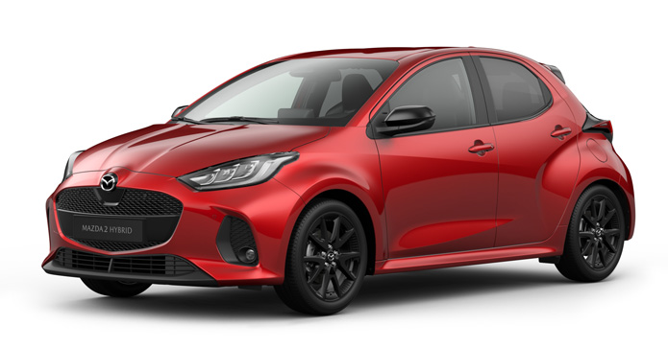
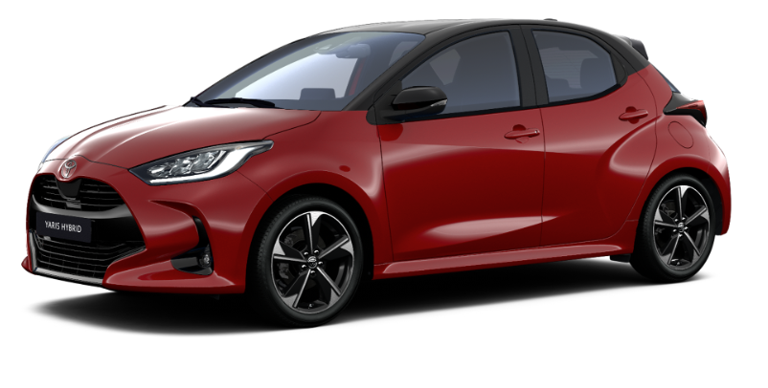
Dragon3: rebadging
Mazda 2 (XP210)
Toyota Yaris (XP210)

Slide 37



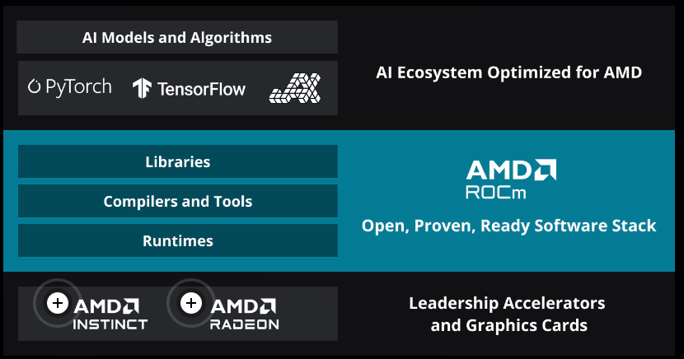
Dragon4: Tech

Slide 38



Dragon4: Tech

Slide 39
Q&A

